Slide 1
ISDS 7070 Final Project
Women’s E-Commerce Review Dataset

Slide 2
Women’s E-Commerce Review Dataset
Includes 23486 rows and 10 unique features
Clothing ID: refers to the specific piece of clothing being reviewed
Age: refers to the reviewer’s age
Title: string variable for the title of the review
Review Text: string variable which includes the text of the review
Rating: score granted by the customer 1 being Worst and 5 being Best review
Recommended IND: binary variable describing if the customer recommends the product or not. 1 = recommend / 0 = not recommended
Positive Feedback Count: documents the number of customers who found the review positive
Division Name: categorical variable describing the division of the product
Department Name: categorical variable describing the department of the product
Class Name: Categorical variable describing the class of the product

Slide 3
Purpose of the Analysis
Goal: To perform Sentiment Analysis on the women’s clothing dataset in order to classify if a review is positive or negative
Allows the customer to better understand the product
Allows the company to receive accurate feedback about the product

Slide 4
Data Wrangling
Deleted ‘ID’ variable from the dataset
Identified and eliminated all rows with missing data
Due to the large number of categorical data eliminating the rows with missing values was more beneficial than replacing the missing values with the most common category per each variable

Slide 5
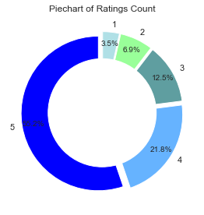
Data Visualization
Pie Chart of Rating count
Over half of the reviews were given a 5-star rating
Over 75% of the reviews received at least a 4-star review

Slide 6
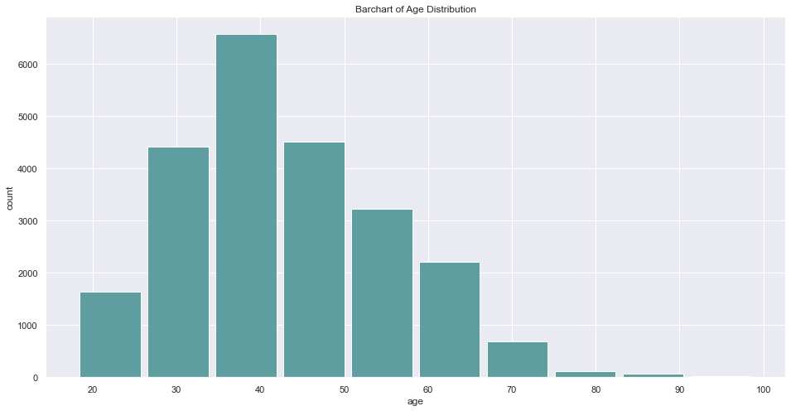
Data Visualization
Count plot of reviews by age
Most reviews were written by customers in their 40’s
Reviews decreased as age of the reviewer decreased after 40

Slide 7
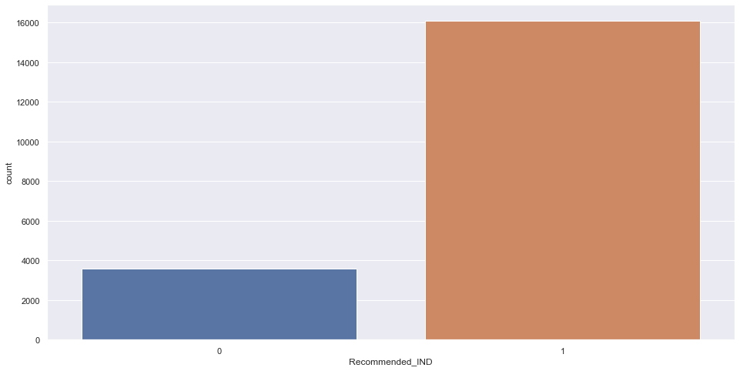
Data Visualization
Count Plot of Recommended IND
Recommended = 82%
Not Recommended = 18%
Assumption: 75% of reviews received 4 or 5 star ratings and 82% of the reviews recommended the product therefore we can assume the recommended Ind variable correlates with the rating review

Slide 8
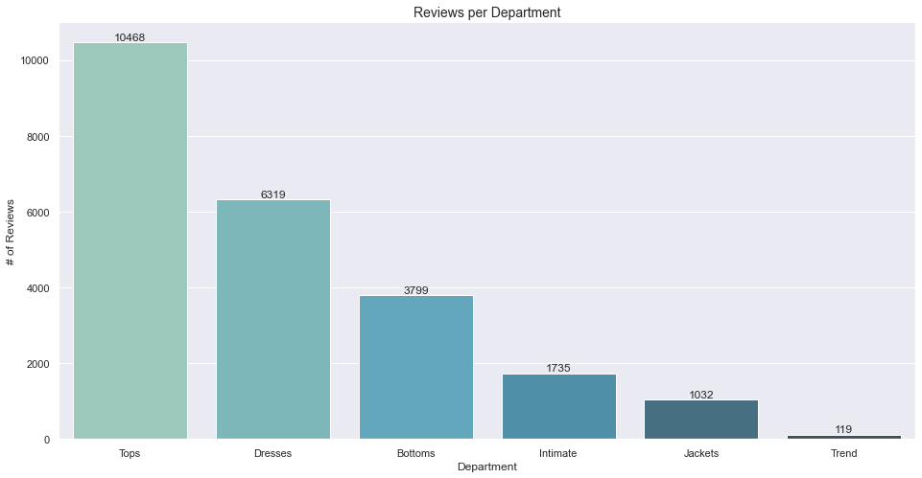
Data Visualization
Reviews per Department
The tops department received the most reviews

Slide 9
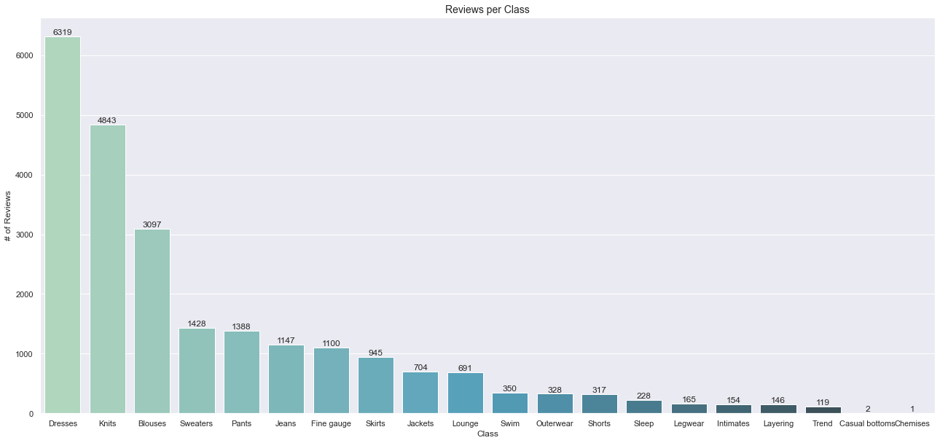
Data Visualization
Reviews per Class
The dress class received the most reviews

Slide 10

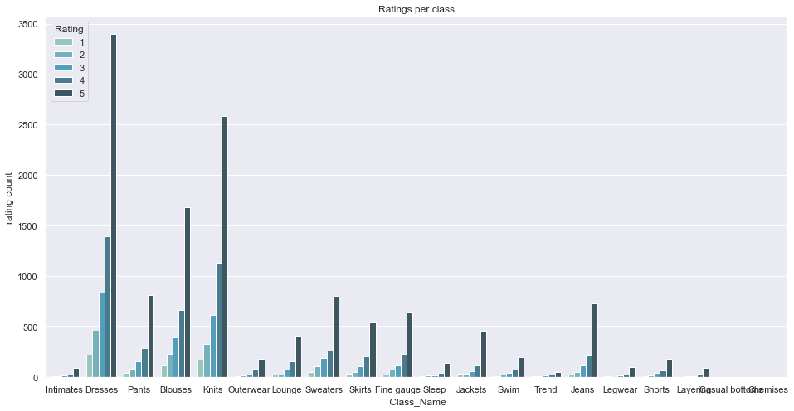
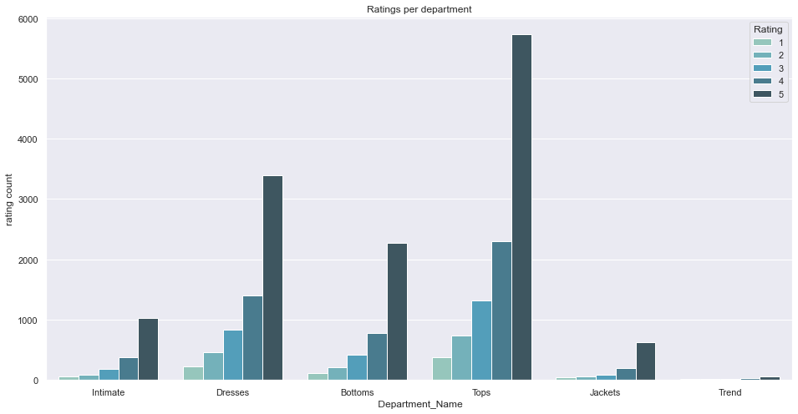
Data Visualization
Count plot of ratings per department and rating per class
Each department and class follow the same trend with most of the reviews per department/class are 5-star reviews and the least being 1-star reviews
Since the trend is the same per each department/class using this variable in the predictive model may not be as impactful

Slide 11
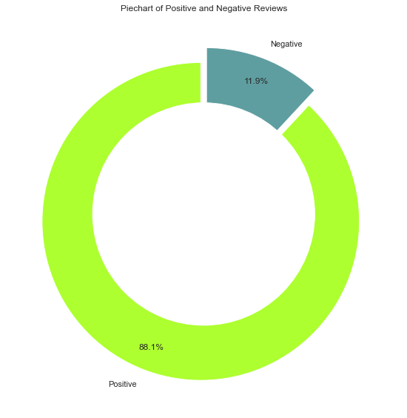
Data visualization
Eliminated 3-star reviews from the data set
3-star ratings are considered neutral and are not beneficial predicting positive/negative reviews
Changed all reviews above 3 stars to positive reviews and reviews below 3 stars as negative reviews
After eliminating the 3-star reviews 88% of the reviews were classified as positive reviews

Slide 12
Machine Learning Models
6 model types were chosen to classify a review as positive or negative
Variables used: ‘Age’ , ‘Text Review’ , and ‘Rating’
Model types:
Naïve Bayes
K-nearest neighbor
SGD
Decision Tree
Logistic Regression
Random Forest

Slide 13
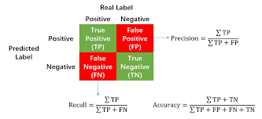
Confusion Matrix
For each classifier the accuracy, precision and recall were calculated to determine which model had the best performance
Accuracy = (TN + TP)/(TN+TP+FN+FP)
The portion of the correctly predicted sentiment to the total number of predicted sentiment
Precision = TP/(TP+FP)
The proportion of positive sentiment were identified correctly
Recall = TP/(TP+FN)
The proportion of actual positives were correctly identified

Slide 14
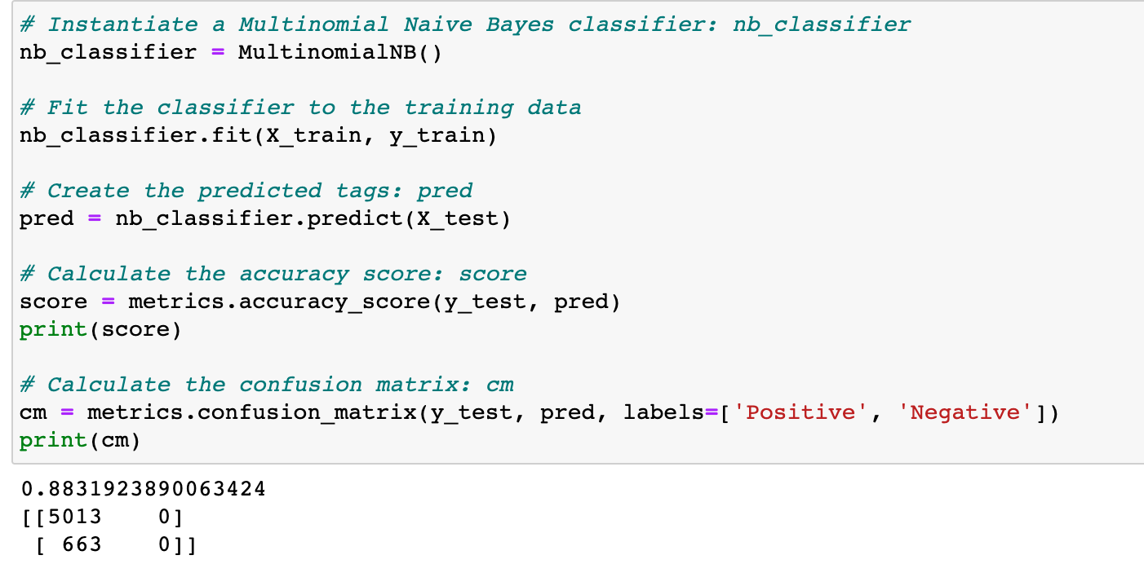
Naïve Bayes Classifier
This classifier is based on the Bayes Theorem with the assumption of independence between every pair of features
Results
Accuracy = 88%
Precision = 100%
Recall = 88.3%

Slide 15
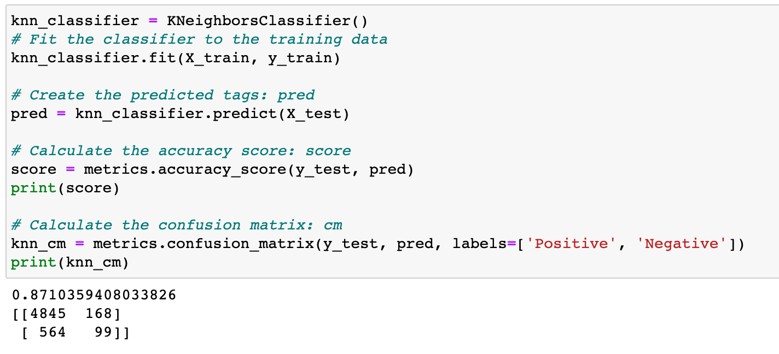
K-Nearest Neighbor Classifier
This classifier is computed by a simple majority vote of the K-nearest neighbor of each point
Results
Accuracy = 87%
Precision = 97%
Recall = 90%

Slide 16
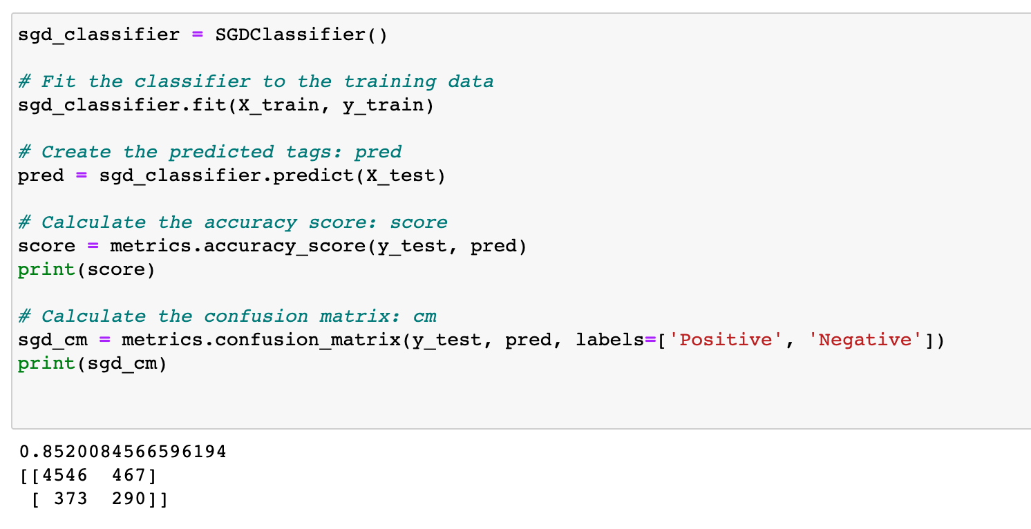
SGD Classifier
SGD classifier is an efficient approach to fit linear models. More useful in large datasets
Results
Accuracy = 86%
Precision = 91%
Recall = 92%

Slide 17
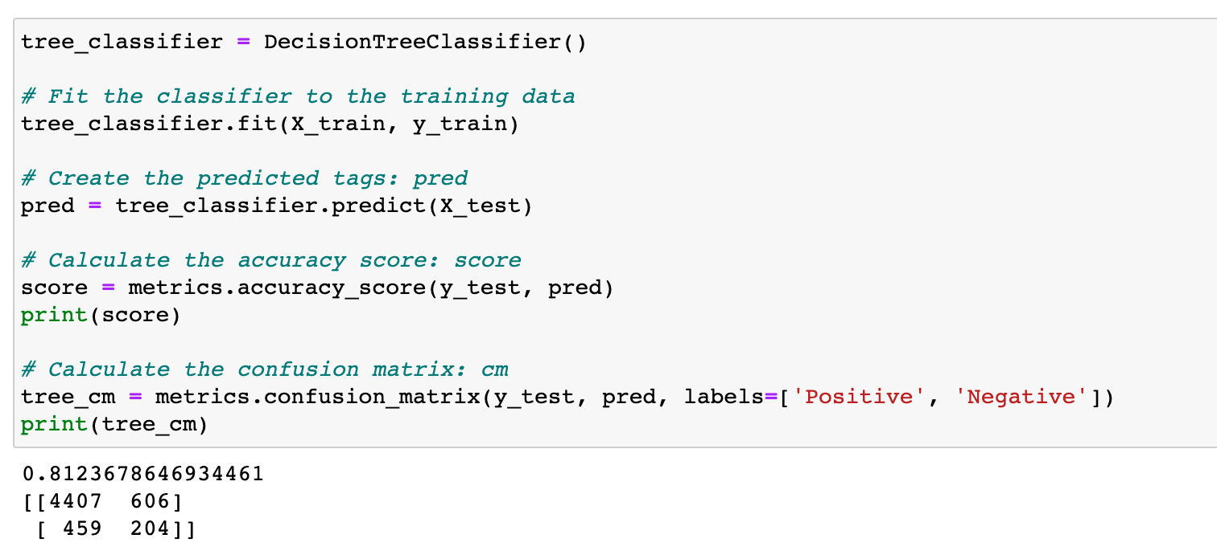
Decision Tree Classifier
The decision tree classifier is a classifier that predicts the value of a target variable by learning simple decision rules inferred from the data features
Results
Accuracy = 81%
Precision = 88%
Recall = 91%

Slide 18
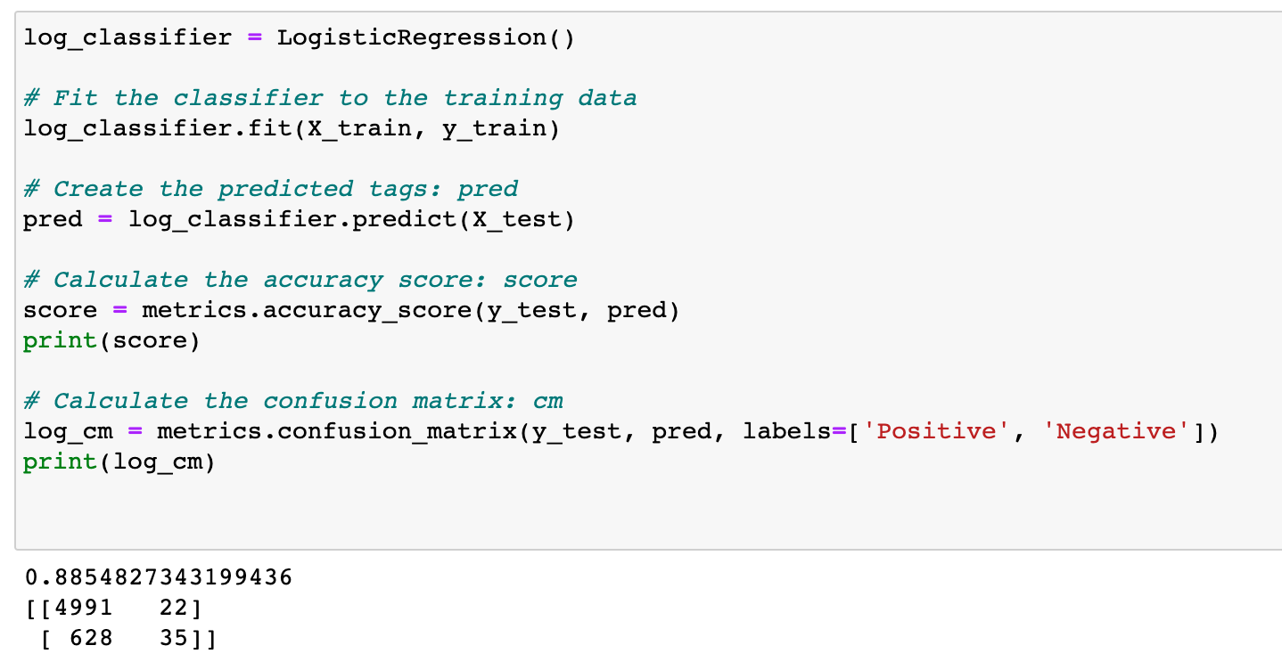
Logistic Regression Classifier
This logistic regression classifier is a classification model which is expressed in the form of conditional probability distribution
Results
Accuracy = 89%
Precision = 99%
Recall = 89%

Slide 19
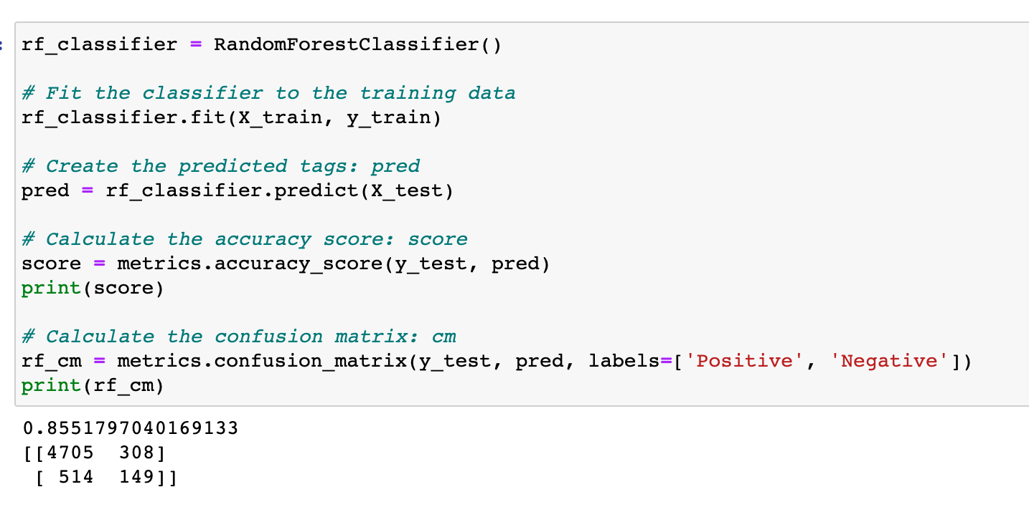
Random Forest Classifier
The random forest classifier is an ensemble learning method for classification. The output of this model is the class selected by most trees
Results
Accuracy = 85%
Precision = 94%
Recall = 90%

Slide 20
Comparison of Model Performance
Model Type | Accuracy | Precision | Recall
Naïve Bayes | 88% | 100% | 88%
K-nearest neighbor | 87% | 97% | 90%
SGD | 86% | 91% | 92%
Decision Tree | 81% | 88% | 91%
Logistic Regression | 89% | 99% | 89%
Random forest | 85% | 94% | 90%
Logistic Regression model received the highest accuracy of all the models
SGD received the highest recall
Naïve Bayes received the highest Precision score

Slide 21
Solution
the goal was to perform Sentiment Analysis on the women’s clothing dataset in order to classify customer review text using machine learning models
6 models were chosen to classify the customer reviews focusing on three variables which included the ‘Review Text’ , ‘Age’ and ‘Rating’ of the reviews
the results show that the logistic regression classifier was the best classifier for this dataset. Not only did the logistic regression receive the highest accuracy it also received the second highest precision score
Moving forward in order to enhance the accuracy of classifying women’s clothing reviews more variables should be considered for the dataset
Region, Salary and occupation of a customer are a few examples of variables that could improve the accuracy of classifying customer reviews through machine learning models

